Slide 1

Brain Tumor Identification and Classification
Created by-
Adarsh Mishra (191500047) Shivani Awasthi(191500769) Aman Kumar(191500092) Aashi Shivhare(191500003)
Submitted To -
Mr. Mayank Srivastava

Slide 2
Table of Content:
1
Introduction
2
Problem Statement
3
Objective
4
Features
5
Tools and Technology Used
6
Motivation
7
Requirements
8
References

Slide 3
Introduction
The brain is a key organ responsible for the central nervous system. The human brain complements the central nervous system by connecting the bone marrow. The brain has the responsibility of controlling the actions of the human body.
It receives the information from a different sense and after making decisions, sends the instructions to the body
1
2
3
Malignant and benign are the currently prevalent types of significant brain tumors. The brain tumor is considered deadly cancer in adults and children.
4
A benign tumor is the least damaging type of tumor and has no tumor cells. Malicious cancer is tumor cells that can be very deadly and deliberate to be deadly. A malignant tumor can affect the entire brain
Quick and timely recognition of a brain tumor is of the utmost importance for curing the tumor. It depends on the expertise and professional skills of the doctor and which method is selected to treat the patient for rapid recovery. It is challenging to determine the correct type of brain tumor in the initial phase.
5
6
Deep learning replicates the brain in data processing, pattern recognition, and decision-making development. Deep neural networks have the competency of unsupervised learning from. unstructured data. Convolutional Neural Network (CNN) works exceptionally well in deep learning

Slide 4

Problem Statement
Recognition of automated brain tumor in Magnetic resonance imaging (MRI) is a difficult task due to complexity of size and location variability. In this research statistical analysis morphological and thresholding techniques are proposed to process the images obtained by MRI for Tumor Detection from Brain MRI Images.
Feed-forward backprop neural network will be used to classify the performance of tumors part of the image.
The results produced by this approach will increase the accuracy and reduce
the number of iterations.

Slide 5

Features
TYPES OF BRAIN TUMOR
grapes, spinach, kale. All blended together for a refreshing drink.
First Image is the example of non-meningioma benign.
Second image is the example of malignant meningioma brain.

Slide 6
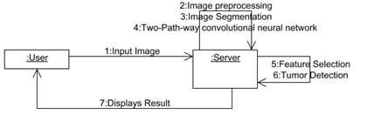

Features

Slide 7
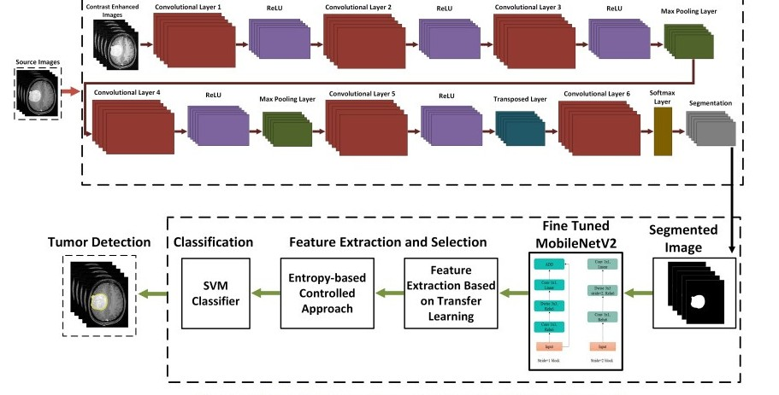

Features

Slide 8

Tools and Technologies
Deep Learning Techniques
Convolutional Neural Networks (CNN)
Python TensorFlow Keras Numpy Scikit-learn Matplotlib OpenCV

Slide 9
Motivation
>Accurate and sharp determining of Brain Tuberculosis
>Doctors become helpful with accuracy
>It learns from past record which make it more accommodate result.
>The accuracy and the robustness of brain tumor segmentation

Slide 10
Requirements
HARDWARE AND SOFTWARE SPECIFICATION
Hardware Requirements Processor : I3 and Above RAM : 4GB and Above
Hard Disk : 500GB and Above
Software Requirements Operating System : Windows 7 , 8, 10 (64 bit)
Tools : Anaconda (Jupyter Note Book IDE)

Slide 11
REFERENCES
>https://www.hindawi.com/journals/acisc/2022
/8104054/.
>https://www.datascience2000.in/2021/05/bra in-tumor-classification-in-deep.html
https://www.sciencedirect.com/science/article
/abs/pii/S0045790622002361?via%3Dihub
https://www.hindawi.com/journals/jhe/2022/2 693621/

